Slide 1
Food Waste Economic Analysis
Alex Badgett, Emily Newes, Anelia Milbrandt
DRAFT – DO NOT CITE/DISTRIBUTE
November, 2017

Slide 2
Modeling Overview

Slide 3
Objectives
Develop an understanding of the economics of Municipal Solid Waste (MSW) sorting and disposal, focus on food waste
Use our understanding to develop economic models for food waste collection and sorting
Model cost of food waste across the U.S. and relate results to Waste-to-Energy (WTE) feedstock potential
NREL Modeling Focus
Waste Collection
Sorting
Disposal
Food Waste Process Flow
DRAFT – DO NOT CITE/DISTRIBUTE

Slide 4
Model Process Flow
Food waste costs broken into two types:
Added: those needed to process food waste as a WTE feedstock (e.g. slurry development, sorting, and de-packaging)
Avoided: costs not applicable if food waste diverted as a WTE feedstock (e.g. landfill tipping fees)
DRAFT – DO NOT CITE/DISTRIBUTE

Slide 5

Modeling Food Waste Cost
We needed to find the cost of food waste that a WTE plant could be expected to pay to acquire the material for use in a WTE process
$${Cost}_{food waste}={Cost}_{added}−{Cost}_{avoided}$$
Added Costs:
-Sorting
-De-packaging
-Slurry development
Avoided Costs:
-Landfill Tipping Fees
The resulting cost can either be positive or negative-therefore a WTE plant could either be paid or have to pay to get food waste for WTE use
DRAFT – DO NOT CITE/DISTRIBUTE

Slide 6
Food Waste National Supply Curve
We modeled food waste costs for every county in the U.S. and aggregated them into the national supply curve shown
Results suggest a large amount of food waste is available at a negative cost
Costs increase quickly when considering small counties producing little amounts of waste (more expensive to process)
DRAFT – DO NOT CITE/DISTRIBUTE

Slide 7
Areas of Further Analysis

Slide 8
Food Waste Infrastructure Development
How will existing waste management infrastructure be modified to process food waste as a WTE feedstock?
Will operators modify existing facilities to process food waste?
Materials Recovery Facilities (MRF)
Transfer Stations (TS)
Landfills (LF)
We assume that counties with an existing waste facility will choose to develop food waste processing technology on the existing site, lowering costs
DRAFT – DO NOT CITE/DISTRIBUTE

Slide 9
Required Equipment for Organics Sorting Facility
How do MRF sorting technologies differ between recycling and organics facilities?
What technologies would be necessary to adapt a recycling MRF for organics sorting?
Possible MRF Components
Rolling Stock
Manual Sorting
Magnet
Disc Screen
Trommel
Slurry Development
Depackaging
DRAFT – DO NOT CITE/DISTRIBUTE

Slide 10
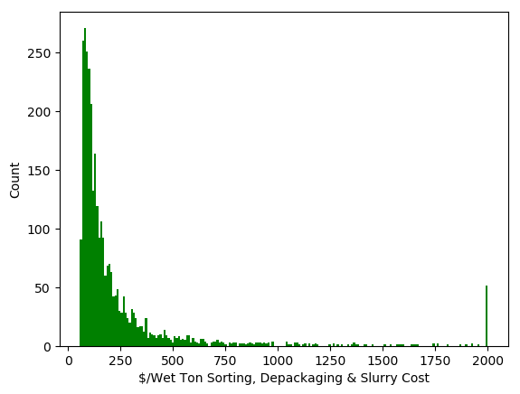
Food Waste Processing Cost Validation
We need to validate the cost distribution of sorting, depackaging, and creating a slurry from food waste
How can we define cost ceilings for food waste sorting?
At what cost will operators export the waste rather than process it themselves?
Small counties with low food waste production result in extremely high sorting costs.
DRAFT – DO NOT CITE/DISTRIBUTE

Slide 11
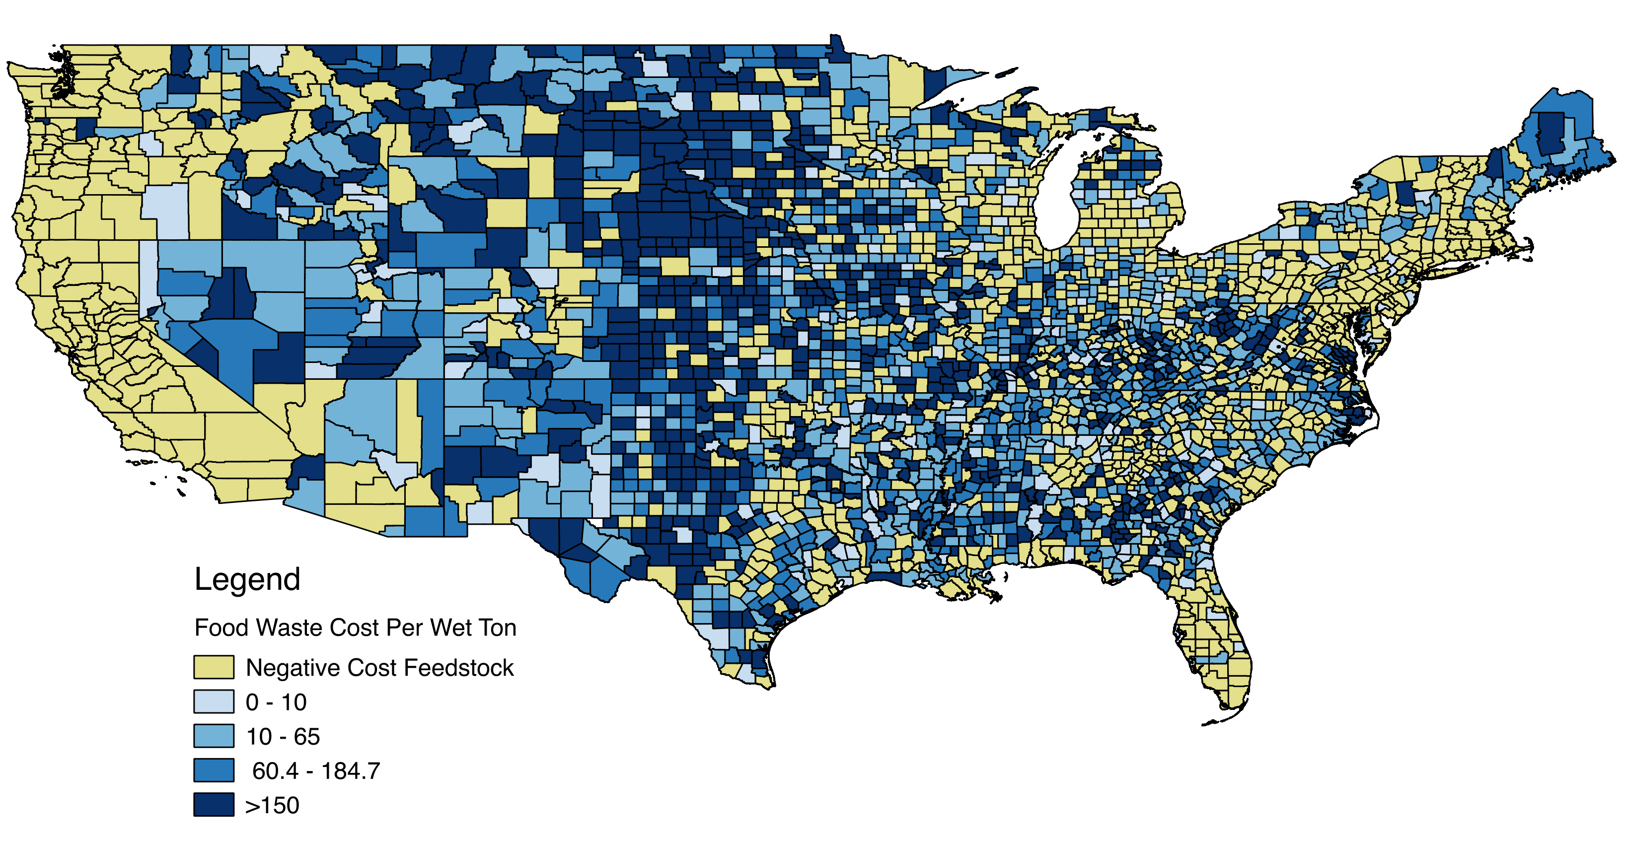
Food Waste Processing Cost Validation
DRAFT – DO NOT CITE/DISTRIBUTE

Slide 12
Thank you!

